Slide 1
Greater Oh-Penn Apprenticeship Network
Partner Briefing
November 17, 2015

Slide 2
Welcome!
Thanks for joining us!
Please enter your name and company/organization in the chat box
We will also use the chat box to field any questions you may have throughout the session
Please mute your phones to alleviate any background noise
Notes:
Welcome state / DOL apprenticeship contacts
Thank everyone for joining us
Recognize mix on the line
This will be recorded, so if you know someone that was not able to join today, please let them know

Slide 3
Purpose of Today’s Webinar
Provide a brief overview of apprenticeships and the benefits of apprenticeships
Provide partners with an overview of the Greater Oh-Penn Apprenticeship Network’s grant project
Review roles and responsibilities
Discuss how you can be involved
Preview next steps
Answer any preliminary questions you may have

Slide 4
Five Core Components of Registered Apprenticeships
Employer Involvement Is Integral
Employer is the foundation for the RA program and
must be directly involved and provider of OJT.
Structured On-the-Job Training (OJT) with Mentoring
Minimum of 2,000 hours
Structured and Supervised
Job Related Education
144 hours recommended per year
Parallel | Front-loaded | Segmented Options
Rewards for Skill Gains
Increases in skills brings about increases in earnings.
National Occupational Credential
Nationally recognized credential showing
job proficiency. Sponsor certifies
individual is fully competent for career.

Slide 5
Why It Works
A proven approach for preparing workers for jobs while meeting the needs of business for a highly-skilled workforce.
It is an employer-driven, “learn while you earn” model that combines on-the-job training, provided by the employer that hires the apprentice, with job-related instruction in curricula tied to the attainment of national skills standards.
The apprenticeship model is leading the way in preparing American workers to compete in today’s economy.

Slide 6
Apprenticeships are Good For Business Benefits To Manufacturers
Helps recruit and develop a highly skilled workforce
Improves productivity and the bottom line
Reduces turnover costs and improves employee retention
Creates industry-driven and flexible training solutions
Potential brand/product improvement via a highly-trained workforce
Opportunities to offset training costs

Slide 7
American Apprenticeship Initiative
To address regional needs, the Greater Oh-Penn Manufacturing Apprenticeship Network will launch the American Apprenticeship Initiative
The American Apprentice Initiative will address specific gaps in skills, training, and barriers to apprenticeship adoption, as well as utilize a vast array of resources to:
Increase manufacturing apprenticeships through strategic support functions, incentives, outreach, and education
Fill critical gaps through targeted recruitment of workers from specific demographics
Increase education providers’ capacity to provide more agile and responsive Related Technical Instruction

Slide 8
AAI Grant Distribution: Industry Sector
Notes:
$175 mil to 46 appliants

Slide 9
Greater Oh-Penn Apprenticeship Innovations
Gaps and Barriers | Innovative Solutions
Manufacturers are uncertain of the ROI | ROI model and related outreach materials Employer reimbursements to encourage participation Peer-to-peer outreach
Current process to start up an apprenticeship program is perceived as involved and daunting | Multi-employer platform to: Registered group sponsored apprenticeships Recruit and screen applicants Develop joint curricula
Apprenticeship programs perceived as long and rigid | Competency-based model
Individuals lack basic and soft skills, preventing entry into manufacturing career pathways | Pre-apprenticeship program leveraging existing partner resources (WIOA, ABLE, etc.)
Low levels of participation in apprenticeship programs from targeted populations | Targeted recruitment of Veterans and Transitioning Service Members, Low Skilled Population, Women and Minorities, and Transitioning Foster Children
Related Techncial Instruction offerings are provided sporadically and at times/places not conducive to apprentices | Modularized and flexible offerings throughout the region with content better aligned to manufacturers’ needs and industry credentials

Slide 10
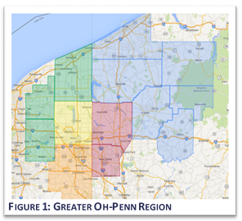
The AAI Grant Footprint
Two States
Ohio and Pennsylvania
Five Workforce Boards
Northwest PA
MCTA – Ohio Area 17
West Central Job Partnership
Geauga Ashtabula Portage – Ohio Area 19
Trumbull County – Ohio Area 18
14 Counties
OH – Ashtabula, Columbiana, Geauga, Mahoning, Portage, Trumbull
PA – Clarion, Crawford, Erie, Forest, Lawrence, Mercer, Venango, Warren

Slide 11
AAI Sector Partners
Mahoning Valley Manufacturers Coalition – Trumbull, Mahoning, Columbiana Counties, OH
Industry Partners of Lawrence & Mercer Counties, PA
NW Pennsylvania Industry Partners – Clarion, Crawford, Erie, Forest, Venango, Warren Counties – PA
Erie Regional Manufacturer Partnership – Erie County, PA
Portage County Manufacturers Coalition – Portage County, OH

Slide 12
Greater Oh-Penn Apprenticeship Partners
Manufacturers, Sector Partnerships
State Apprenticeship Councils
State and Local Workforce Systems
Education and Training Providers
Adult Basic Literacy and Education
Community-based organizations
United Way in several counties
Economic development organizations

Slide 13
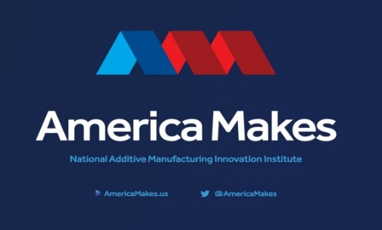
State and National Partnerships
NIMS
National Tooling and Machining Association
Manufacturing Institute
Lightweight Innovation for Tomorrow (LIFT)
Digital Manufacturing Design and Innovation Institute
America Makes (NAMMII)
Ohio Manufacturers Association
Pennsylvania’s Manufacturer & Business Association

Slide 14
Goals
To markedly increase Greater Oh-Penn region manufacturers’ ability to meet their needs for highly skilled and credentialed employees and willingness to use customized registered apprenticeship models.
To streamline apprenticeship and employee candidate recruitment, assessment, and pre-screening operations with different service providers and “on-ramps,” facilitating the process of matching appropriate candidates with manufacturers’ needs.
To increase representation of target populations in registered apprenticeship programs in the region, particularly veterans and foster children transitioning into adulthood, ultimately improving their long-term prospects for stable employment and self-sufficiency.

Slide 15
Goals / Grant Requirements
300 new apprentices registered by Year 5 of the project
Year 1: 25
Year 2: 50
Year 3: 75
Year 4: 75
Year 5: 75
Indicators of increased system-wide support for registered apprenticeship across the region
Ongoing formal Workforce Board commitments to fund pre-apprenticeship training and apprentice wages
Long-term manufacturer commitments to program expansion

Slide 16
USDOL Expectations
Meet the Goals of Statement of Work
Create new apprenticeship ecosystem, and integrate Registered Apprenticeship as part of workforce transformation
Implement Registered Apprenticeship programs and register apprentices
Align systems in support of Registered Apprenticeship
Sustain partnerships to drive future expansion
Ramp-Up Quickly and Effectively
Report Accurately and Timely
Monitor Progress

Slide 17
Grant Funding
Support for apprenticeship training cost – current or new employees
$6,000/apprentice in Year 1
$5,000/apprentice in Year 2
$4,000/apprentice in Year 3
$3,000/apprentice in Year 4
$2,000/apprentice in Year 5
Group sponsorship model design, including recruitment and screening
Easy-to-use toolkit, ROI model, other outreach materials
Related Technical Instruction technical assistance and coordination
Liaisons with state offices, manufacturers, and partners
Notes:
Existing or new employees

Slide 18
Governance Structure
Advisory Council
Project Manager
Steering Committee
Oh-Penn Work-based Learning Action Team
NW PA Work-based Learning Action Team
MVMC Executive Director
Apprenticeship/Sector Partnership Coordinator
Apprenticeship/Sector Partnership Coordinator
MVMC Administrative Assistant
Advisory Council - responsible for ensuring the project remains demand-driven, providing guidance and industry expertise
Steering Committee - oversee the implementation of the project with specific focus on the development and improvement of various aspects of the model.
Work-based Learning Action Teams - group of individuals responsible for implementation with a focus on building and strengthening relationships among partners involved in the initiative

Slide 19
Governance Structure
Advisory Council
Project Manager
Steering Committee
Oh-Penn Work-based Learning Action Team
NW PA Work-based Learning Action Team
MVMC Executive Director
Apprenticeship/Sector Partnership Coordinator
Apprenticeship/Sector Partnership Coordinator
MVMC Administrative Assistant
Advisory Council - 2 manufacturing reps from each of the sector partnerships
Steering Committee
Advisory Council + 1 member from each of the following:
State Apprenticeship Office
Community Colleges
Universities
Career and Technical Centers
Work force Boards
Adult Basic Education
TANF
Wagner Peyser Veterans Services and
Community-based Organizations
Work-based Learning Action Teams - anyone interested in participating; practitioner level
Notes:
Ask for those interested in serving on the Steering Committee to contact Sue Watson

Slide 20
Role: West Central Job Partnership
Serve as fiscal agent
Serve as project manager (Eric Karmecy) dedicated to grant administration and overall support for programmatic activities
In addition to grant reporting, coordination with local Workforce Boards to create consistent processes and procedures, coordination with American Job Center partners to promote apprenticeships and encourage referrals of individuals to the pre-apprenticeship programs and referrals of manufacturers to learn more about the apprenticeship program, and
Coordinate with the national evaluator

Slide 21
Role: Mahoning Valley Manufacturers Coalition
Develop prototypes for several apprenticeship occupations
Serve as group sponsor, registering apprenticeships on behalf of manufacturers with DOL and/or serve as a technical assistance intermediary for employers who wish to register their own programs
Contract with Coordinators
Coordinate peer-to-peer outreach
Coordinate apprenticeship referrals coming in and route them to the appropriate employer partners

Slide 22
Role: Thomas P. Miller & Associates
Provide sector partnership coordination and outreach to manufacturers to promote apprenticeships
Coordinate Advisory Council and Steering Committee
Develop apprenticeship model collateral materials and IndustryNeedsYou website
Coordinate related technical instruction providers, curriculum improvement subcontractor, community colleges, and pre-apprenticeship partners
Serve as Apprenticeship Coordinators to:
Act as liaisons in each state to coordinate and supplement state apprenticeship staff outreach to manufacturers,
Conduct presentations and educational sessions/webinars,
Coordinate manufacturer peer-to-peer outreach,
Coordinate with partners for recruitment to pre-apprenticeship programs

Slide 23
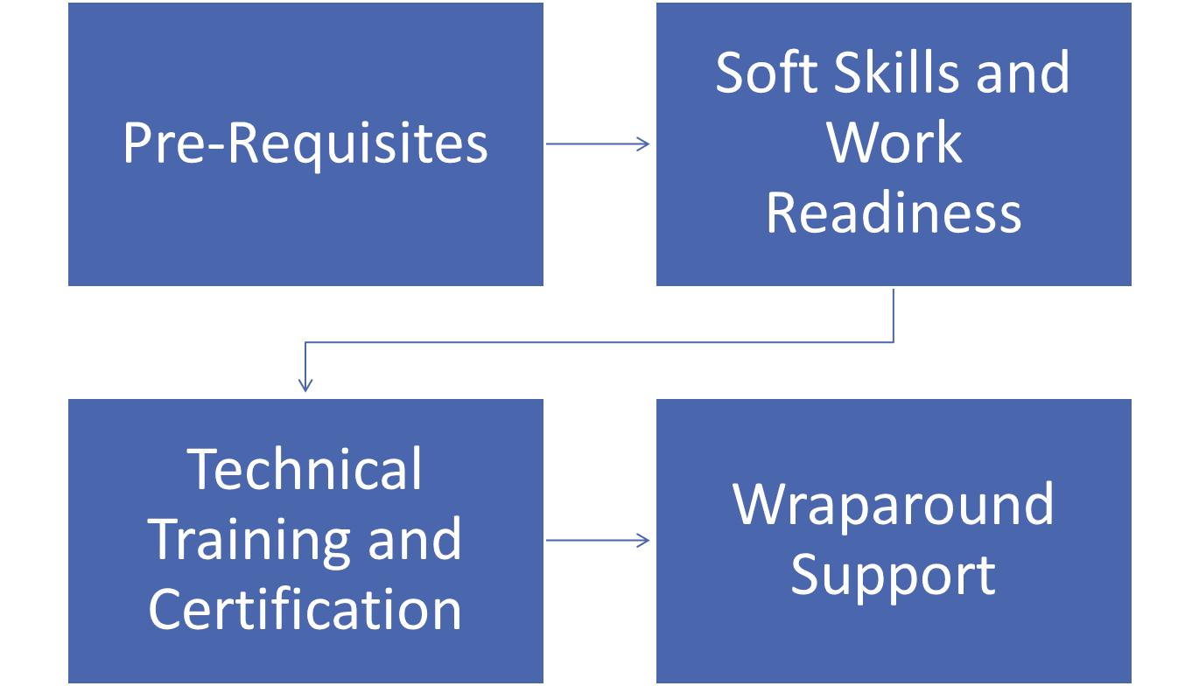
Pre-Apprenticeship Component
Best practice/evidence-based
Prepares individuals to
enter into a career pathway and succeed in semi-skilled manufacturing production positions and/or
possess the requisites for entry into more advanced manufacturing skill training—including apprenticeship
earn OSHA 10, NCRC, & MSSC CPT
Notes:
Sara
Now positioning as a Pre-apprenticeship Program
Emphasize 7 credentials in 7 weeks

Slide 24
Pre-Apprentice Component
Leveraging braided funding
Oh-Penn Workforce Innovation Fund (ended October 31, 2015)
Ohio Industry Workforce Alliance grant (2 addl cohorts through June 30, 2015)
Adult Basic Literacy Education – in support of contextualized remediation
WIOA – commitment to support one cohort in each Workforce Area per year for the five years of the AAI grant
Other possible sources/related activities
Industry Partnership Worker Training Grant
Strategic Innovation Grant
NW PA Workforce Innovation Fund Grant
Erie Regional Chamber and Growth Partnership-led efforts

Slide 25
Next Steps
Governance
Solidify Advisory Council membership
Solidify Steering Committee membership
→Contact Sue Watson at swatson@tpma-inc.com
Initial Outreach
Identify early adopter manufacturers
Additional information on IndustryNeedsYou.com/apprenticeships
Add information and links to other sector partnerships
Cross promote Industry Needs You on Facebook
Model Development

Slide 26
PROJECT TEAM
Jessica Borza (Overall Project Lead)
330-853-7906
jborza@tpma-inc.com
Sara Hunt (Career Pathways/Model)
330-388-9325
shunt@tpma-inc.com
Sue Watson (Project Coordinator)
330-307-3399
swatson@tpma-inc.com
J. Diane Karlin (Employer Engagement)
330-501-0081
dkarlin@tpma-inc.com
Danielle Hosey (Pre-Apprenticeship)
330-531-2008
dhosey@tpma-inc.com
Jessica Driscoll (Outreach and Communications)
330-787-6897
jdriscoll@tpma-inc.com

Slide 27
Q & A

Slide 28
Thank You!

