Slide 1
The Future of Manufacturing
Notes:
Manufacturing Careers Here and Now!
Good morning, everyone! I’m so excited to be here to talk about the good jobs that are available in manufacturing.
Many people in our area have old ideas about manufacturing. So I’m here today to talk a little about manufacturing today and in the future.

Slide 2
Manufacturing: Strong and Growing
Accounts for nearly 11% of total regional employment
Represents nearly 40,000 employees in the 5-county Interstate Region
$67,079 average annual earnings per job
$2.66 Billion in total earnings for the region
Notes:
Manufacturing today is strong and growing
If you look at the top industries in our area, you can see that Manufacturing is the second largest and 11% of people (nearly 40,000) are working in industry in our region.
And manufacturing doesn’t just benefit the people working in it - the nearly 1,200 Manufacturing employers, export over $12 billion in goods each year!

Slide 3
Manufacturing: Strong and Growing
$
Notes:
Most manufacturing employees also have excellent benefits—including paid vacation, health coverage, retirement planning and tuition reimbursement.
nearly double the average wage.
The average pay in our area for other industries is $34,725
Bottom line is that manufacturing pays well above the averages.

Slide 4
Manufacturing Careers
Manufacturing Career Data
Job title | Minimum Education Needed | Wage Range | Projected Employment 2021
Mechanical Engineers | Associates Degree | $17-44 | 470
Machinist | CTC Certificate of Completion | $10-23 | 2100
Welders/ Welder Fitter | CTC Certificate of Completion | $20-30 | 1427
Fabricators | CTC Certificate of Completion | $10-30 | 1634
Supervisors of Production & Operating Workers | CTC Certificate of Completion | $13-37 | 2003
Fabrication and Fitters | CTC Certificate of Completion | $17-24 | 530
Quality Technicians/Inspectors | CTC Certificate of Completion | $10-27 | 1351
Tool and Die Maker | CTC Certificate of Completion | $12-34 | 725
Production Workers | CTC Certificate of Completion | $11-18 | 1589
 |  | Average Wage: $27.00 | Total Employment: 11,829
Notes:
From jobs that only require Short Term training or On the Job Training, to those with Masters or Doctorate Degrees, it is important to know that there are Careers in Manufacturing for many different skills and levels of education. And unlike many other fields, with Manufacturing there are many opportunities for you to get paid while you learn an advanced skill on the job.
Even with jobs that only require Short Term or On the Job training, you still need to have some mathematic and problem solving skills. Being able to operate, program a machine or understand blueprints are necessary skills to have to work in today’s manufacturing industry.
Also, in the past, manufacturing was more of a male-dominated field, but not so today. With innovations in technology replacing the need for brute strength, Employers nowadays are looking to hire innovative people that possess skills and credentials that they can use on the job.

Slide 5
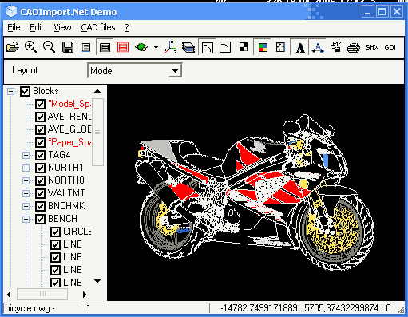
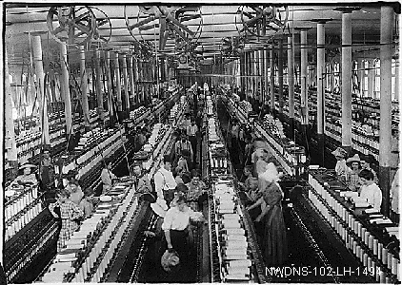
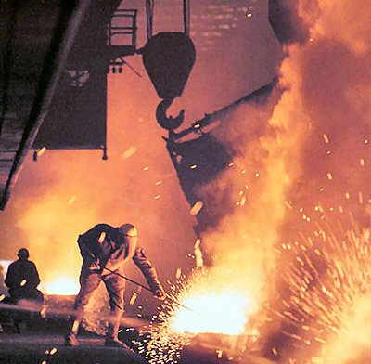
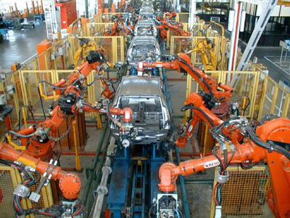
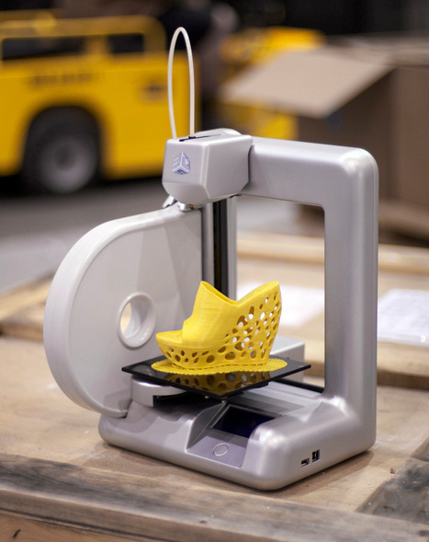
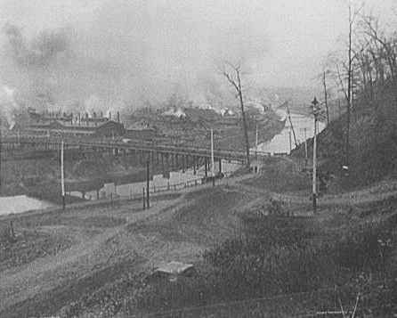
Manufacturing Then vs. Now
Notes:
Manufacturing Then vs. Now
In previous generations, manufacturing facilities were loud and dirty places…and those images live on in movies and stories are parents and grandparents tell us about their mill days. But, today’s manufacturing workplace has evolved significantly. Most have adapted to more advanced manufacturing. Today’s manufacturing has been modernized. Safety is the top priority and modern workplaces are clean, well-lit spaces.
Labor intensive jobs and outdated facilities of the past have been replaced by innovative, facilities using computers and high precision technologies operated by a skilled workforce.
Stress importance of skills
3D printing is one of the most popular recent innovations in Manufacturing. You got to see the new National Additive Manufacturing Innovation Institute—it’s been making news all across the country—and it’s right here in our own back yard. 3D Printing is going to revolutionize the industry.
While in traditional manufacturing you start with raw material, like steel or plastic, and take away sections of it to make the shape you desire, with 3D printing (or Additive manufacturing) the printer is programmed to add material in Micro thin layers to form the finished product.
…and who knows what other new innovation may be just around the corner?

Slide 6
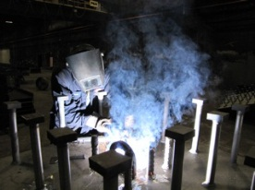
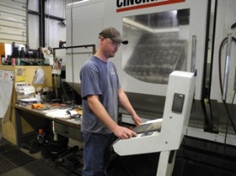
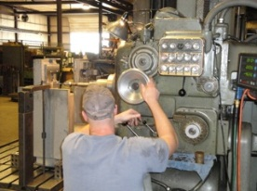
Industry Needs You
Common Problem:
not enough skilled workforce
Businesses are growing and expanding
Many older workers are retiring
More need due to oil and gas industry
Notes:
And Industry Needs You!
And here’s why:
One of the most common problems is that there is a shortage of people going into Manufacturing with in-demand skills.
Manufacturing in our Region is growing – 7% from 2009 to 2011 an increase of 2,300 jobs and in a recent survey Companies indicated that if they could find workers with the right skills, they could hire as many as 1,100 more people.
So you will be coming into the job market at the PERFECT TIME to get a manufacturing job

Slide 7

Manufacturing Offers
Jobs are in demand
Competitive Salaries
Little or No Debt
Steady and Stable Work
Career Pathway
Diverse Opportunities
Notes:
What can Manufacturing mean for you?
Already talked about the many great paying jobs and not enough people to fill them---that means opportunity for you and other young people.
The goal of getting education and training is so that you can get a good career that supports you and your family’s lifestyle.
Because manufacturing jobs are booming, you can earn a great salary that supports the lifestyle you want.
Training programs to get skills needed to get a job are typically shorter and less expensive. You can even get started in high school. Then, if you want to go on to college, manufacturers will pay for continuing education==tuition reimbursement.
Your goal should also include doing something you enjoy and find interesting. Manufacturing can provide you with more than just a job now…it’s a career pathway—meaning you will have opportunities for advancement your entire working life.
Manufacturing is very diverse and offers a lot of opportunities for people with a wide variety of interests.

Slide 8

Your Future, Your Career
10th grade- 12th grade
  Consider a vocational program
After Graduating
  Technical Education
  Apprenticeships
  College
Notes:
So as you are coming closer to graduating from School you should be thinking about what you want to do with your future. There are many options and it can seem overwhelming, but that is why I am here to help guide you with some career pathways. Here are some options to take a look at that would gear you towards a great career!
And for those of you who do have a plan, you may start somewhere and find out that it doesn’t really interest you after all.

Slide 9
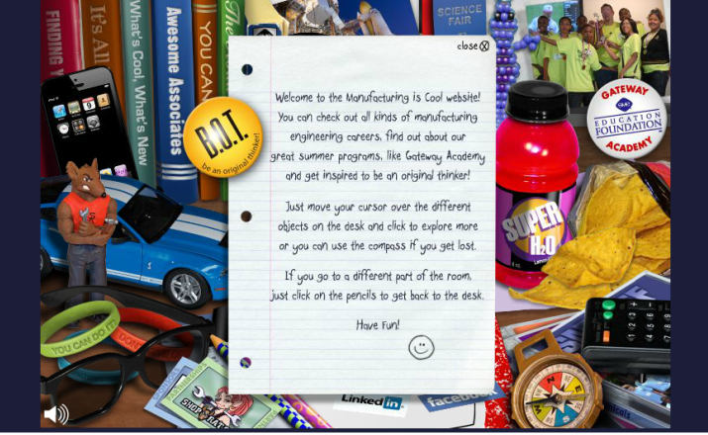
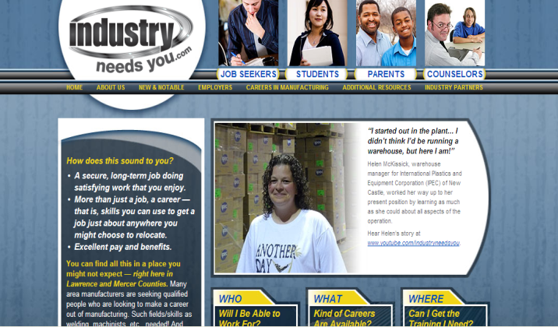
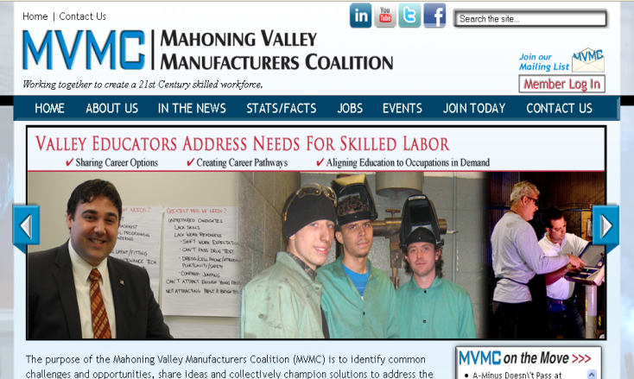
More Information & Resources
www.ManufacturingIsCool.com
www.IndustryNeedsYou.com
www.mvmanufacturing.com
Notes:
More Information on Manufacturing
If you haven’t already done so, I strongly recommend you to view the “Industry Needs You” and Mahoning Valley Manufacturers website which give you a snapshot of many of our local employers, there products, or what steps were taken by some employees to jump start their careers.
Also, the “Manufacturing Is Cool” video which is a manufacturing oriented interactive website to use for a fun learning tool or possible career aid.

Slide 10

Thank You!
Notes:
So as you’re thinking about what you are going to do after graduating high school, be aware of all the career opportunities available in the Manufacturing Industry, not only in the our region, but around the country and world.
I hope that you learned something today that will help you in making career decisions for your future.
Does anyone have any questions?
Thanks for your attention and have a good day!

